Slide 1


Chrislin, Dhivya, Rajeshwari, & Varun

Slide 2


Project analysis slide 3
Intro into PUBG
DATA CLEANING
FEATURE ENGNEERING
Exploratory Data Analysis
MODEL BUILDING
EVALUATION

Slide 3





Project analysis slide 3
Intro into PUBG
Elements of PUBG
MATCH
Match can be Solo, Duo, Squad; We have used Solo matches for our analysis
~5100 Solo matches are present in the dataset
KILLER
Players use different weapons to kill other players
They can also assist in killing
FEATURE ENGNEERING
MODEL BUILDING
EVALUATION
WEAPON
45 weapons in dataset. We will shortly see which ones are more lethal.
VICTIM
A player becomes a victim once he/she is killed by a fellow victim

Slide 4




Project analysis slide 3
Intro into PUBG
Match Characteristics
SURVIVAL TIME
Time each player is able to survive over the match
PLACEMENT
Rank of each player in a match which is displayed after the match ends
FEATURE ENGNEERING
MODEL BUILDING
EVALUATION
DISTANCE
Distance rode or walked by each player
DAMAGE
Damage caused by a player to fellow contestants

Slide 5
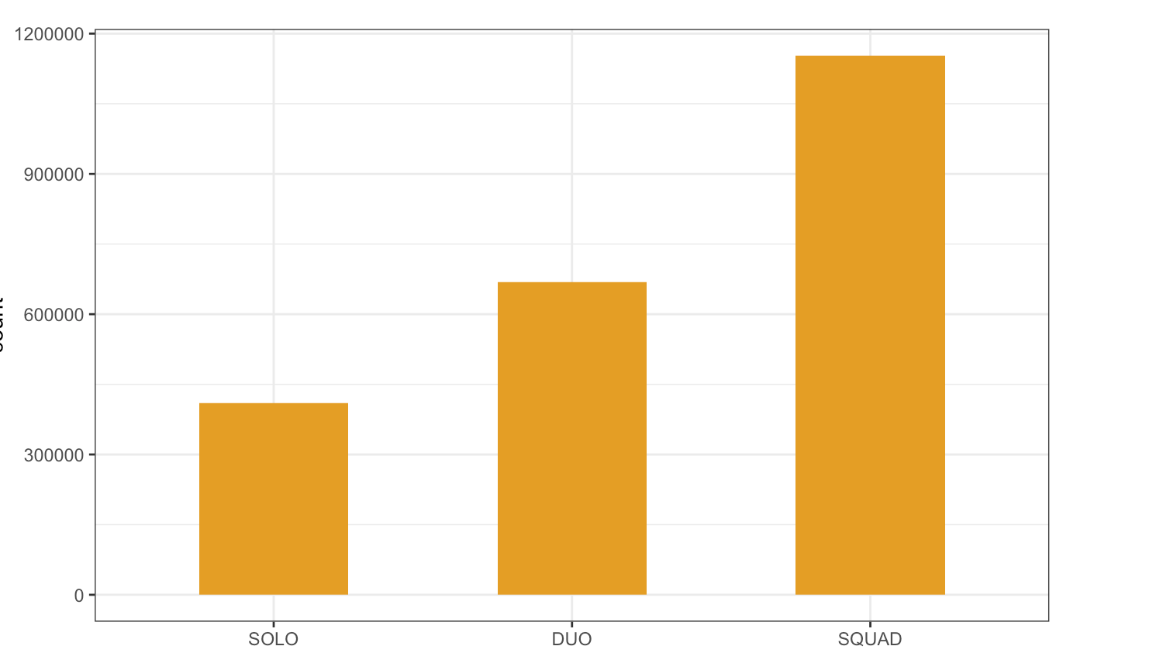
Project analysis slide 3
Data Analysis
# of Matches Under Each Type
FEATURE ENGNEERING
MODEL BUILDING
EVALUATION
Frequency
Match Type
Note: Weapon Score is based on Normalized average # of kills per match

Slide 6
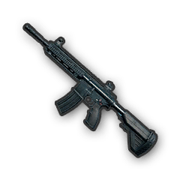
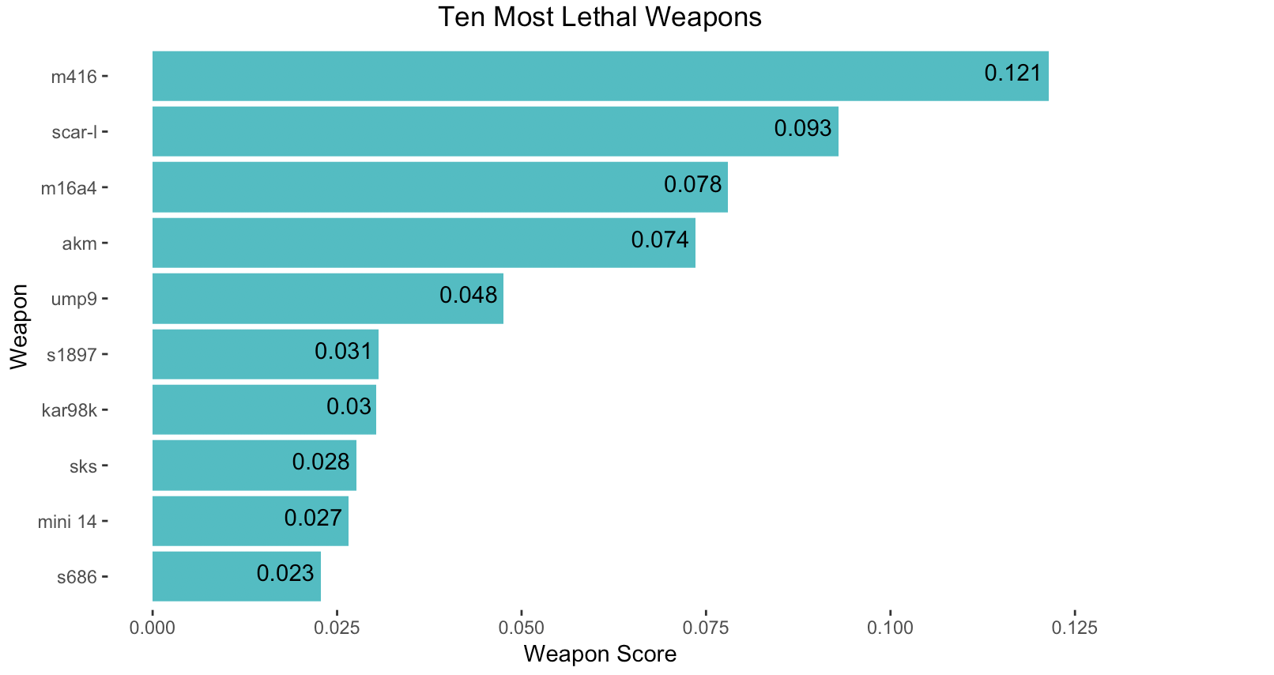
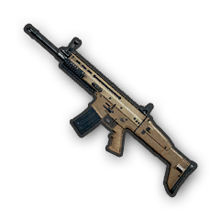
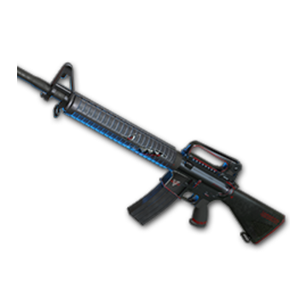

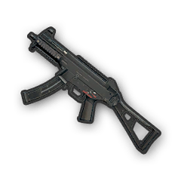


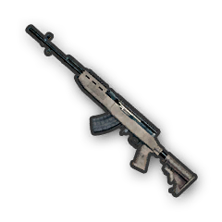
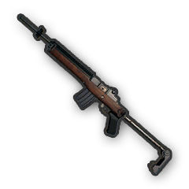

Project analysis slide 3
Data Analysis
TOP 10 LETHAL WEAPONS
FEATURE ENGNEERING
MODEL BUILDING
EVALUATION
Weapon Name
Weapons like awm, aug, groza are other common weapons used by top 10 players
Weapon Score
Note: Weapon Score is based on Normalized average # of kills per match

Slide 7
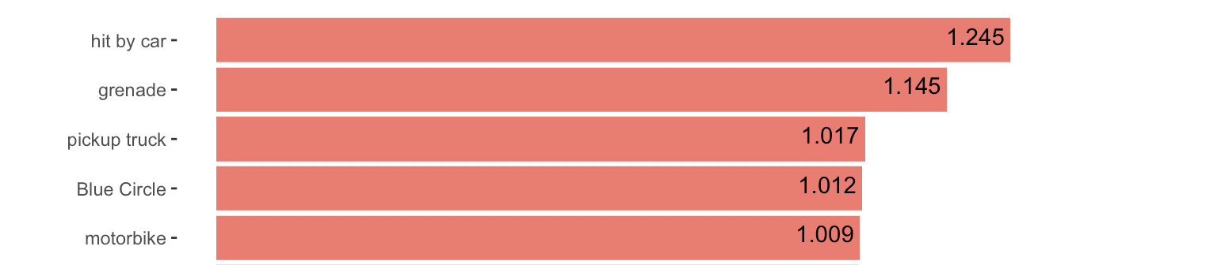
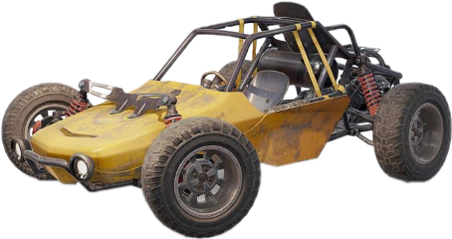
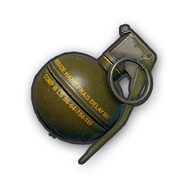

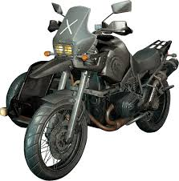
Project analysis slide 3
Data Analysis
TOP 5 PROPELLER OF ACCIDENTAL SELF KILLS
FEATURE ENGNEERING
MODEL BUILDING
EVALUATION
Weapon Name
Average # of Self Kills Per Match

Slide 8

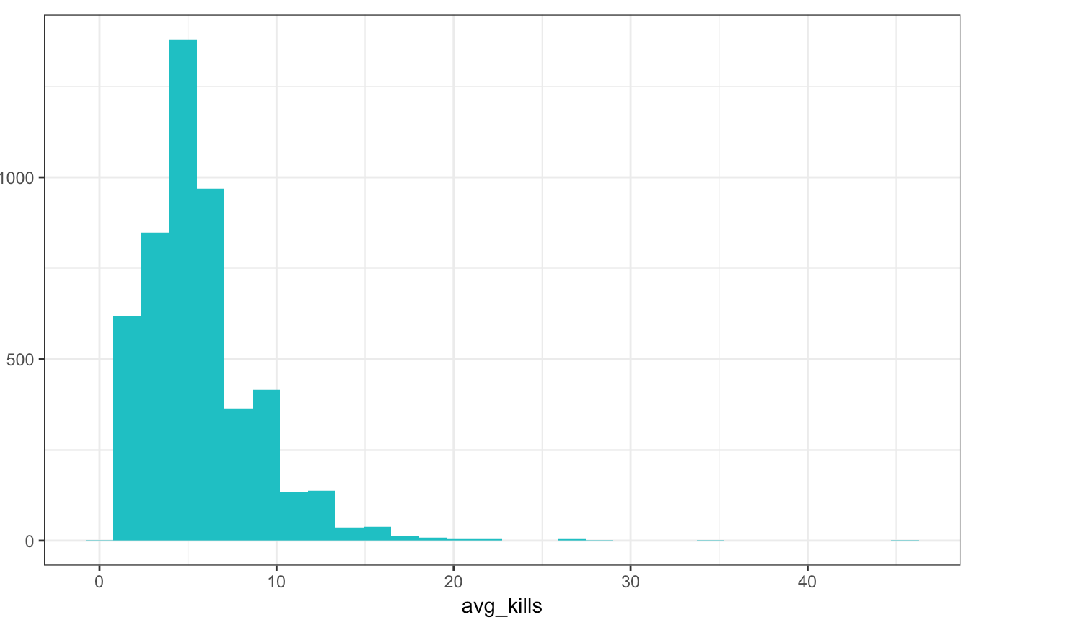
Project analysis slide 3
Data Analysis
WINNERS CLUB
FEATURE ENGNEERING
MODEL BUILDING
EVALUATION
Frequency
Average # of kills / match

Slide 9
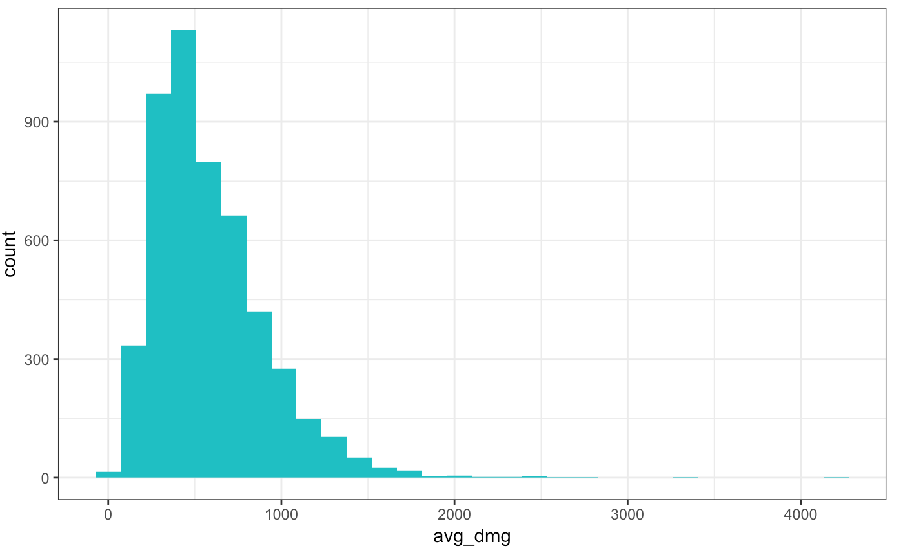
Project analysis slide 3
Data Analysis
WINNERS CLUB
FEATURE ENGNEERING
MODEL BUILDING
EVALUATION
Frequency
Average damage / match

Slide 10
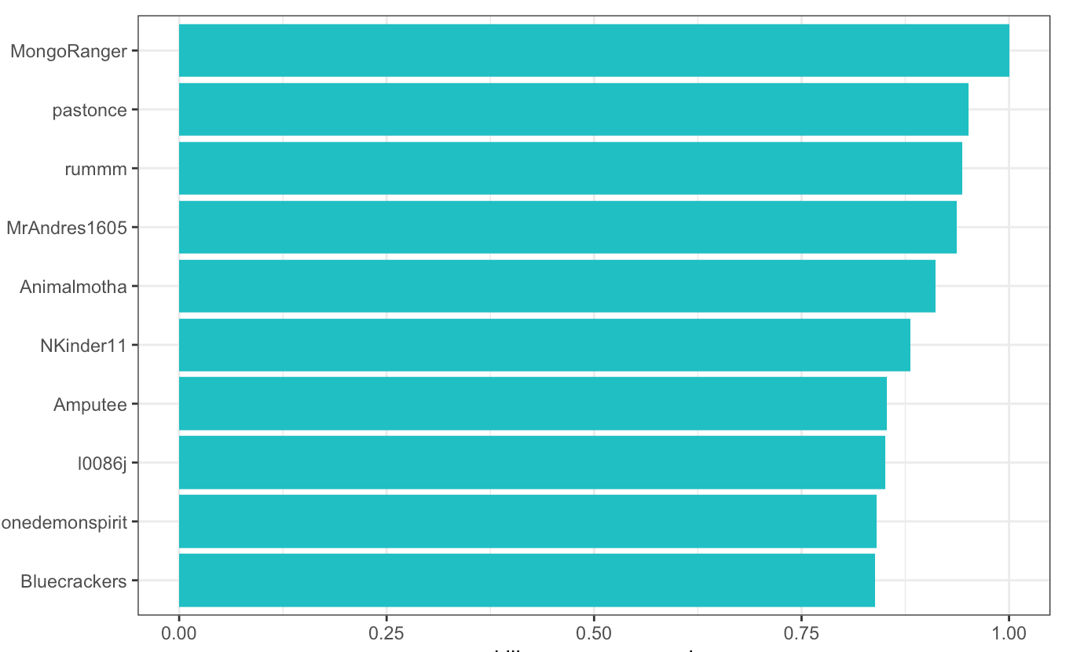
Project analysis slide 3
Data Analysis
WINNERS CLUB
FEATURE ENGNEERING
MODEL BUILDING
EVALUATION
Killer Names
Killer Score
Note: Killer Score is based on Average # of kills per, Average Damage, Average Assists, Average Time, Average Distance, Weapon Score per match

Slide 11
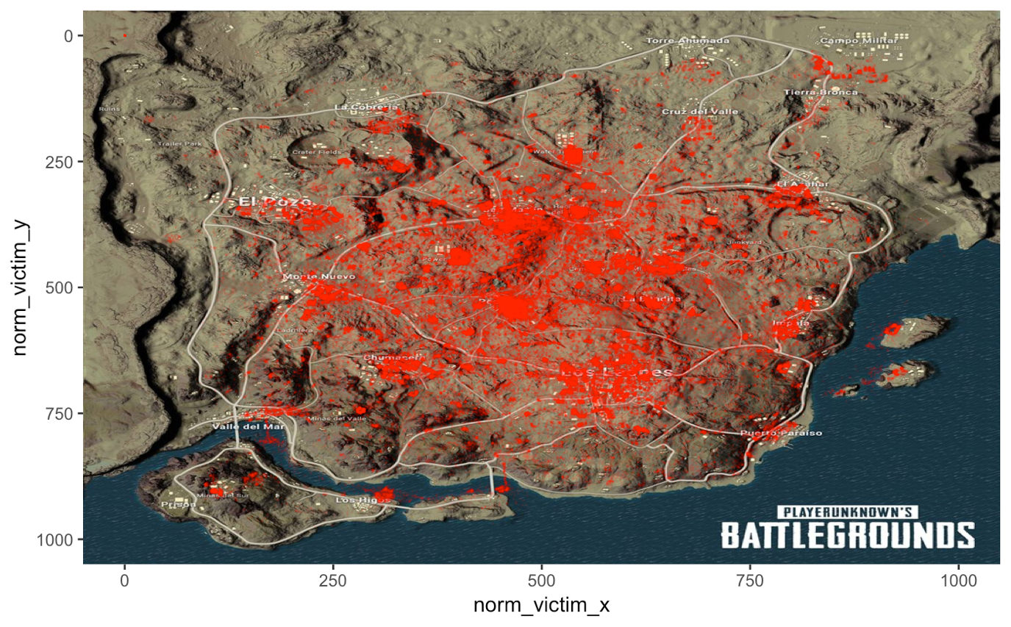
Project analysis slide 3
Data Analysis
MIRAMAR MAP: DEATH HOT SPOTS
FEATURE ENGNEERING
MODEL BUILDING
EVALUATION

Slide 12
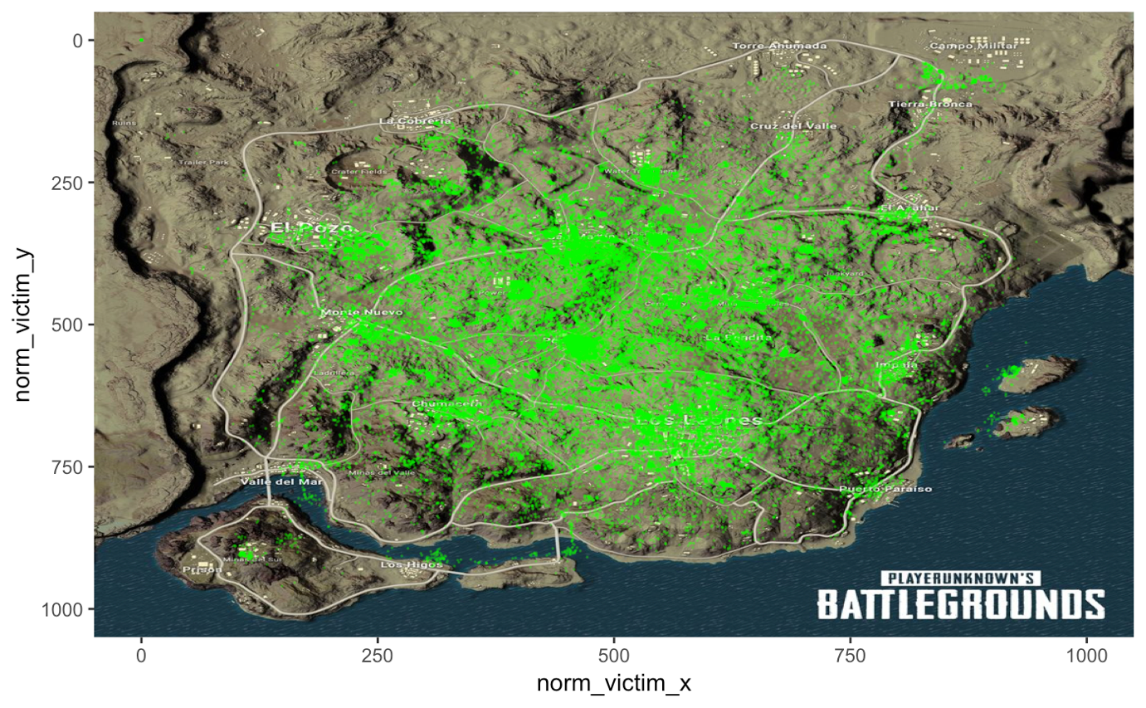
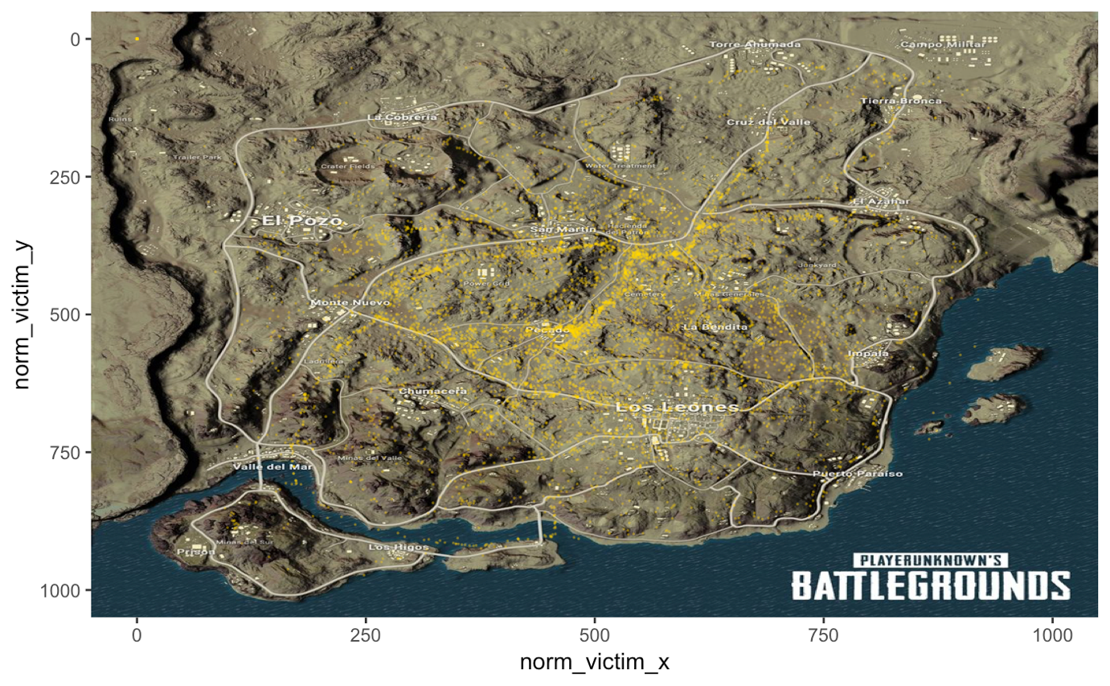
Project analysis slide 3
Data Analysis
KILLS FROM M416
SELF KILLS BY CAR
MODEL BUILDING
FEATURE ENGNEERING
EVALUATION

Slide 13
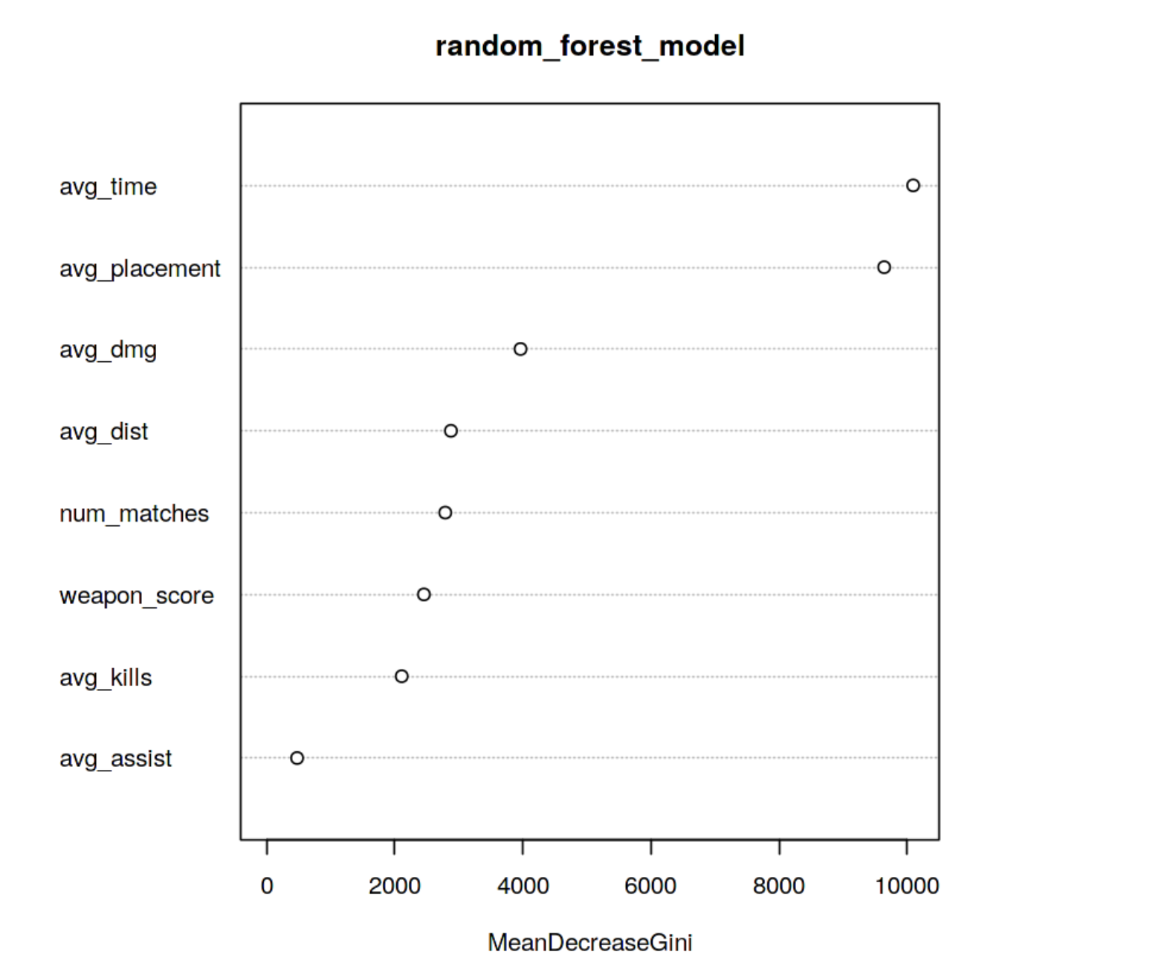
Project analysis slide 3
Model Building
RANDOM FOREST FOR PREDICTING IF A PLAYER WILL BE IN TOP 10 OR NOT
FEATURE IMPORTANCE
CONFUSION MATRIX
 | ACTUAL
PREDICTED |  | TRUE | FALSE
 | TRUE | 31237 | 8304
 | FALSE | 3709 | 35832
FEATURE ENGNEERING
MODEL BUILDING
EVALUATION
EVALUATION
ACCURACY: 84.8%
F1 SCORE: 83.9%

